Slide 1

Project 3
Seth Hanusik

Slide 2
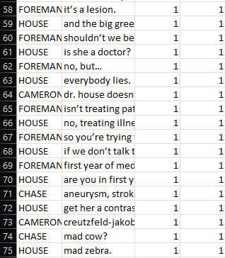
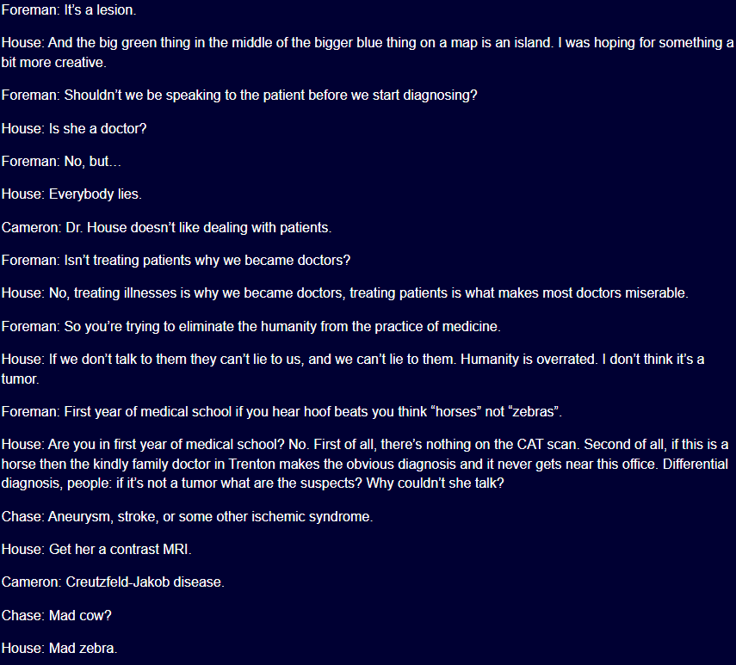
Data
Scripts were scraped from the web page using python and formatted into a CSV with the character, line, season, and episode.
S1E2-5, S7E18, and S8E23 were excluded because the formatting was not correct.
S1E9 is included but the web page only contained part of the episode.

Slide 3
Discoveries
While House is expected to have the most lines, Wilson, Chase, Foreman, and Cuddy all appear in nearly as many episodes, but House has three to five times as many lines.
The word ‘house’ is one of the top, if not the top word for each of the character’s word cloud.

Slide 4
DEMO

